Slide 1

Analyse Image Classification of MNIST Datatset
Team Name : CodeCube
Team Members:
Alam Sher Khan (Matriculation Number: 1387324)
Aiman Zehra (Matriculation Number: 1388996)
Soundarya Talawai (Matriculation Number: 1390133)

Slide 2
Table of Content
Abstract
Introduction
Methodology
Working Process of Training Images
Finding HTM Parameters
Similarity between Images of Same Label
Correlation Matrix
Graphical Representation of Micro Similarity of Images in Label ‘Nine’ and ‘Zero’
Similarity between Images of Different Labels
Result of graphical representation Macro Similarity ‘Nine vs One’ at Potential Radius=1,10,20,30
Prediction Code
Conclusion

Slide 3
Abstract
Our objective of this project is to examine the HTM (Hierarchical Temporal Memory) parameters which results in the highest micro similarity for the image classification of MNIST (Modified National Institute of Standards and Technology) dataset.
We also provided the prediction code for classification so that after learning, system can predict the quality of training.
The prediction code will calculate the highest similarity in between the testing image and the training images of the label (Dataset).
The prediction code will give the name of the label which is predicted with the highest similarity.

Slide 4
Introduction
Image Classification has the potential to make use of efficient knowledge representation techniques when combined with knowledge gained by training of images.
Hierarchical temporal memory (HTM) is a machine learning technique inspired by the neocortex and developed to learn and anticipate sequences. It should be able to generate generalized representations for similar inputs in its empirical way.
Various HTM parameters change has been experimented in this project in order to identify their influence on the similarity of MNIST dataset.
Relation between the micro and macro correlation has been plotted in graphical representation.

Slide 5
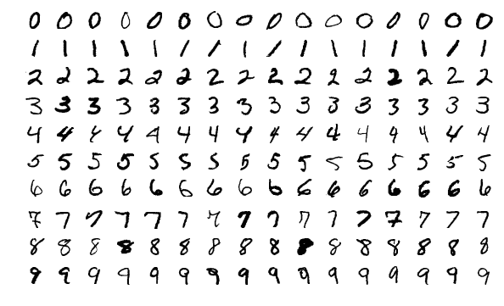
Methodology
The Spatial Pooler in a standard HTM system accepts input from an encoder and outputs to the Temporal Memory. The main goal is to convert the binary vectors into a semantically comparable SDR with constant sparsity.
The dataset used in this project is MNIST images dataset. It is a large database of handwritten digits that is commonly used for training various image processing systems. The database is also widely used for training and testing in the field of machine learning.

Slide 6
Working Process of Training Images
Fetch all images inside Folder Path images
Loop all images inside the ‘InputFolder’ across each learning class (label)
Train Spatial Pooler with each image for several iterations
After several iterations Spatial Pooler enters STABLE state
Find the similarity between SDRs of images within same class (Micro Correlation) and between different classes (Macro Correlation)
Print similarity matrix of Macro and Micro Correlation

Slide 7
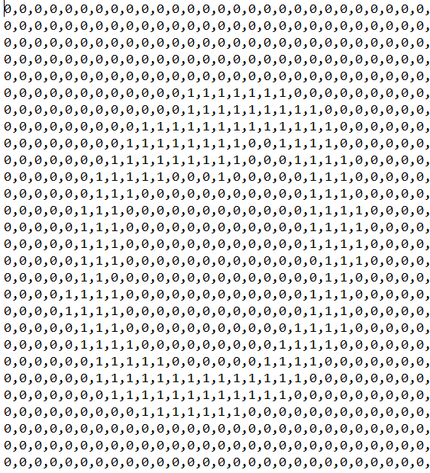
Continued..
Encoder/Binarization:
An encoder converts arbitrary input into a format that an HTM can understand. This input must be always an SDR. The activation state ('0' or '1' for inactive and active, respectively) of the columns from the previous area in the HTM is represented by each bit in the SDR.
Binarization
Bits are saved in the form of an Array
Input Image
Binarized Image

Slide 8
Continued..
Spatial Pooler:
The Spatial Pooler transforms input patterns into SDRs in a continuous online fashion. The HTM temporal memory learns temporal sequences of these SDRs and makes predictions for future inputs. The spatial pooler implies pools or clusters data in the spatial dimension. Each pattern that appears at the input during the spatial pooler's learning process is compared to the database of other patterns.
Sparse Distributed Representation:
SDR is an effective information organization system. Sparse means that only a tiny percentage of the big, interconnected cells are active at any given time. Because the binary representation is more biologically reasonable and extremely computationally efficient, HTM considers the binary SDR converted from a specific encoder.

Slide 9
Finding the HTM Parameters
Several experiments have been conducted in order to analyse how the classification of image is affected by changing the spatial pooler parameters, local area density and potential radius on images of same class and between images of different class.
Local area density defines the number of active columns within a local inhibition area, we specify the desired density of active columns by changing LocalAreaDensity parameter in the htmconfig.json file.
Potential radius determines the extent of the input that each column can potentially be connected to. This can be thought of as the input bits that are visible to each column. This number determines how far a column's effect spreads over the HTM layer.

Slide 10



Similarity between Images of Same Label
Images used in the training:
Label ‘Nine’
Micro Similarity of Images in Label
Steps 1: Set the HTM Parameters (i.e.)
PotentialRadius
GlobalInhibition
LocalAreaDensity
InputDimension
ColumnDimension
Steps 2: Run the Application in Visual
Studio to find the correlation matrix
Label ‘One’
Label ‘Zero’

Slide 11
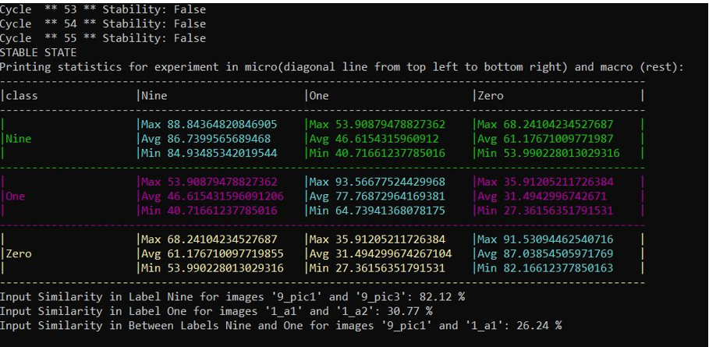
Correlation Matrix

Slide 12
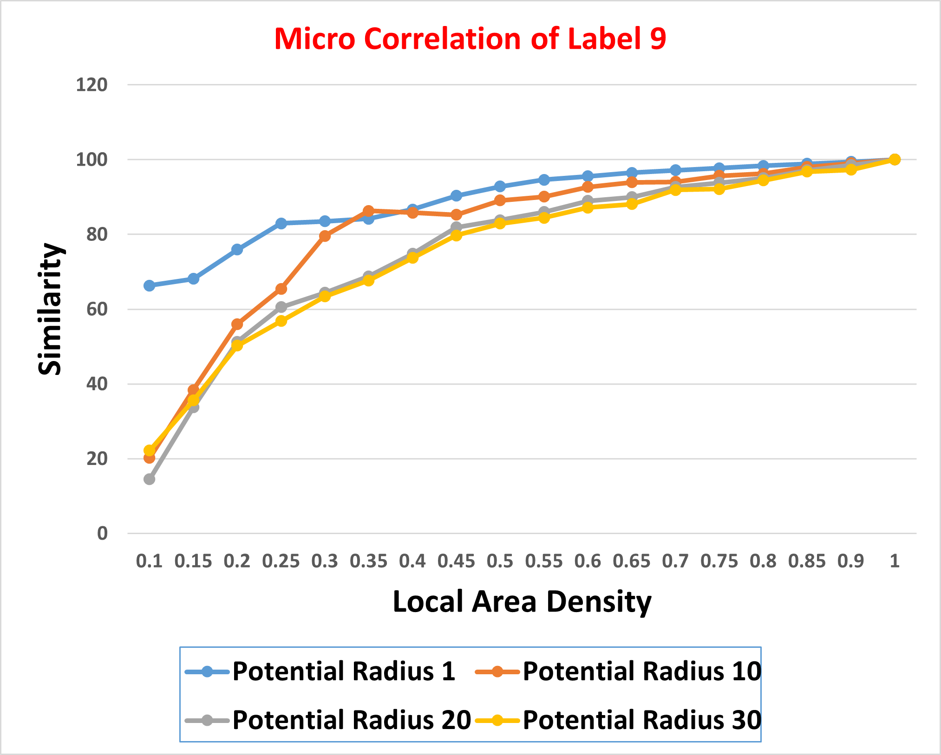
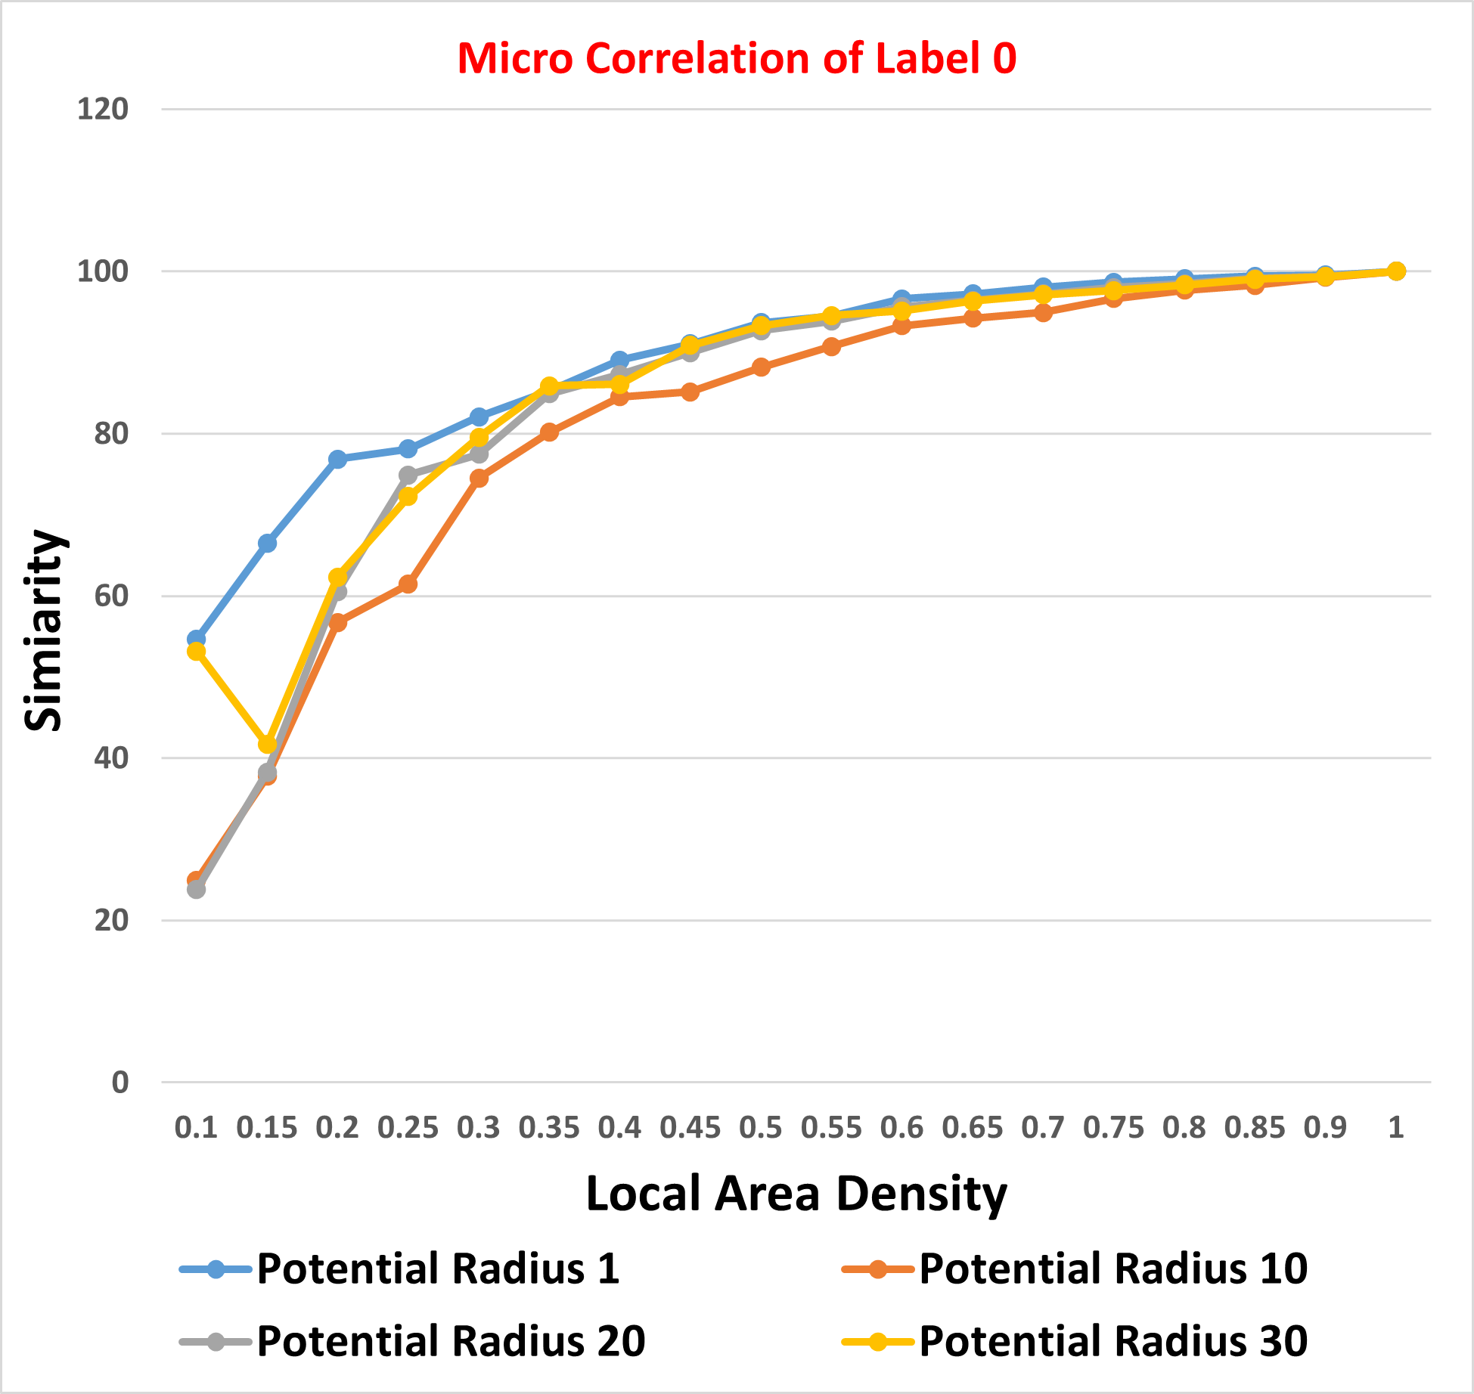
Graphical Representation of Micro Similarity of Images in Label ‘Nine’ and ‘Zero’

Slide 13
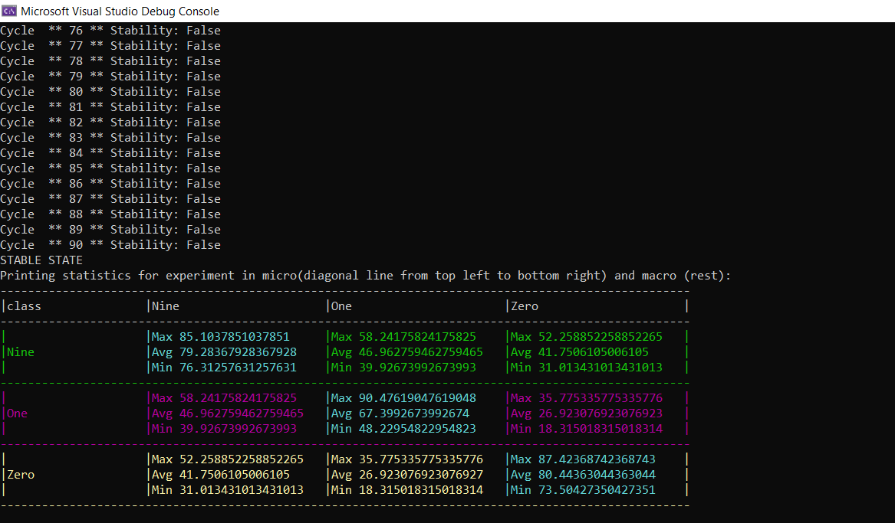
Similarity between Images of Different Labels
Macro Similarity ‘ Nine vs One’ at Potential Radius=1,10,20,30

Slide 14
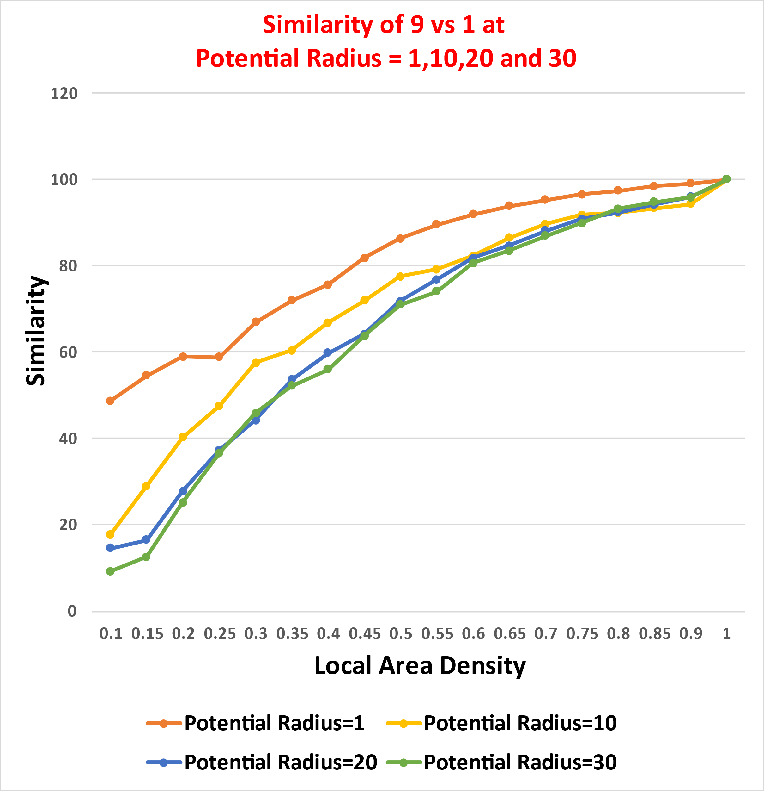
Result of graphical representation Macro Similarity ‘Nine vs One’ at Potential Radius=1,10,20,30

Slide 15
Prediction Code
After the learning phase is completed and similarity matrix of Macro and Micro correlation is generated for all the classes, the SDR of the image to be predicted is compared with each of the SDRs of the images learned during the training phase.
The prediction code will calculate the Highest similarity in between the testing images and training images of the label (Dataset).
The prediction code will give the name of the label which is being predicted with the highest similarity.
When we enter the image which is completely different from the training images(Dataset), in this case the prediction code will show a message as "The similarity of testing Image is too low, hence the given image might not belong to the training dataset"

Slide 16
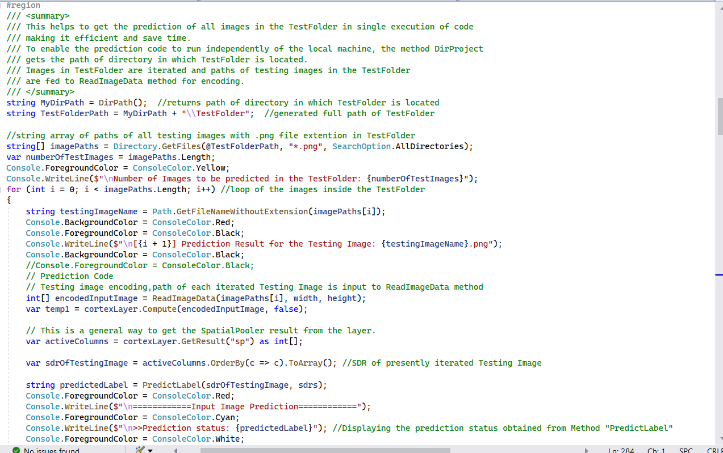
Code for Prediction

Slide 17
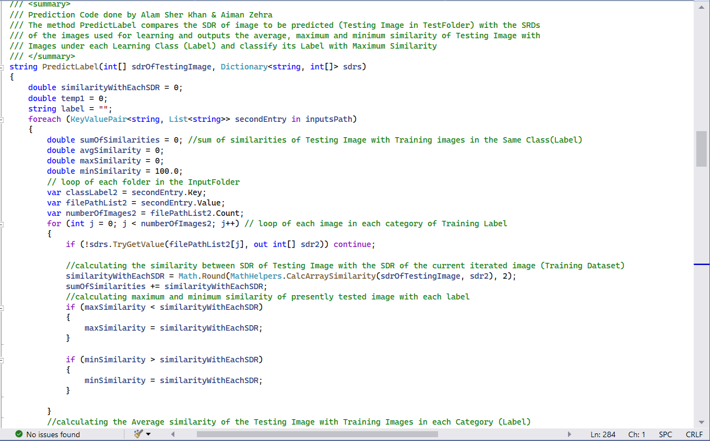
Continued..

Slide 18
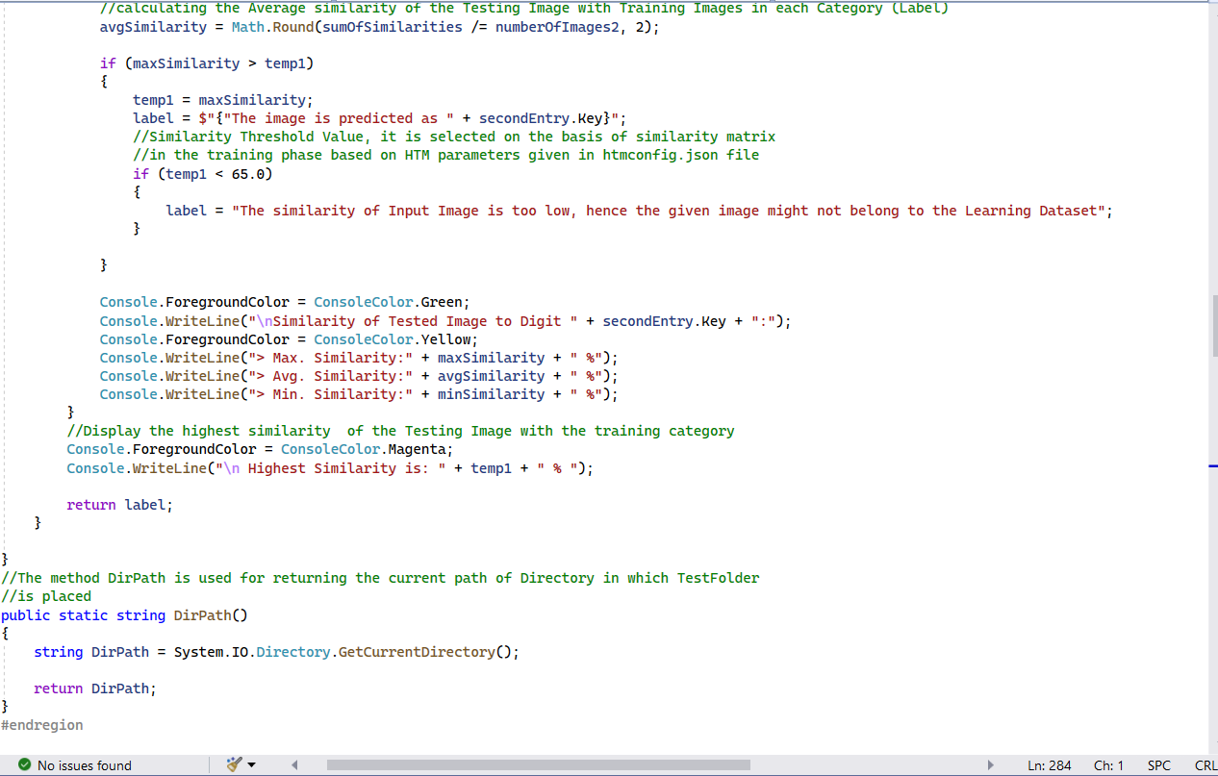
Continued..

Slide 19
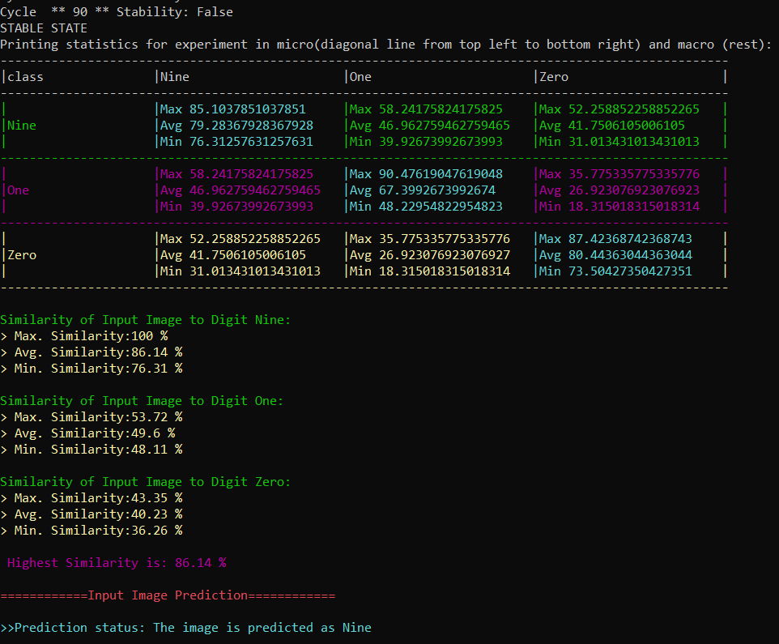
Case 1: When the test image is similar to the training images (MNIST Dataset)
Test Image:
Training Images: (Label 9) (Label 1) (Label 0)

Slide 20

Case 2: When the test image is different from the training images (MNIST Dataset)
In this case, we have considered two situations:
When the testing image belongs to MNIST dataset but is not used as an input image in the training phase.
For example: Testing Image:
Training Images:
(Label 9) (Label 1) (Label 0)
When the testing image is any random image (not belongs to MNIST dataset)
For example: Testing Image:
Training Images:
(Label 9) (Label 1) (Label 0)
Continued in next slides for the prediction results of above cases

Slide 21
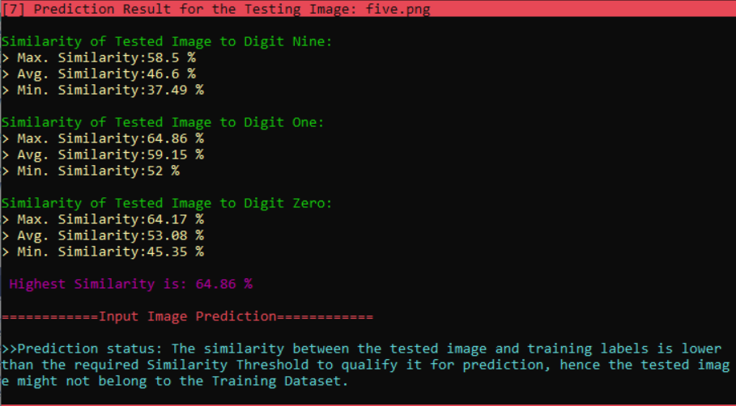
Continued…
1. When the testing image belongs to MNIST dataset but is not used as an input image in the training phase.
Testing Image: (Label five)
Training Images:
(Label 9) (Label 1) (Label 0)

Slide 22
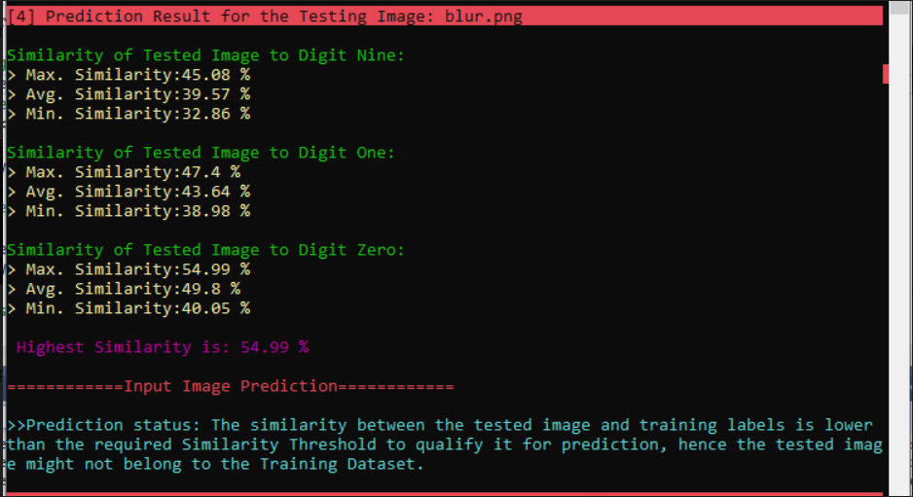
Continued…..
2. When the testing image is any random image (not belongs to MNIST dataset)
Testing Image: (Label blur)
Training Images:
(Label 9) (Label 1) (Label 0)

Slide 23
Conclusion
The results show how potential radius and local area density parameters influence the similarity. The similarity increases as the local area density is increased and images of same image class and different image class appears to be similar.
We found that for local area density value of 1, the image matches 100% irrespective of whatever the image is taken.
The experiments were also helpful in understanding how local area density and potential radius can influence the prediction of images based on training.
We can conclude that if large number of columns remain active within a local area inhibition, the similarity between the images will be more and they appear to me similar. So, for the different class of images not to appear similar, the local area density must be as low as possible.

Slide 24
References
[1] | J. Mnatzaganian, E. Fokoué and D. Kudithipudi, "frontiers in Robotics and AI," [Online]. Available: https://www.frontiersin.org/articles/10.3389/frobt.2016.00081/full.
[2] | "Wikipedia," [Online]. Available: https://en.wikipedia.org/wiki/MNIST_database.
[3] | D. Dobric, "Github," [Online]. Available: https://github.com/ddobric/neocortexapi-classification.
[4] | G. D, "How the brain might work: a hierarchical and temporal model for learning and recognition," Stanford University, Stanford, CA, USA, 2008.
[5] | J. Hawkins, S. Ahmad and D. Dubinsky, "Hierarchical Temporal Memory including HTM Cortical Learning".
[6] | "Numenta," [Online]. Available: https://numenta.com/resources/biological-and-machine-intelligence/spatial-pooling-algorithm/.
[7] | J. Hawkins and C. Maver, "Biological and Machine Intelligence," BAMI, 2019. [Online]. Available: https://numenta.com/assets/pdf/biological-and-machine-intelligence/BaMI-HTM-Overview.pdf.

